Slide 1


The Ethics & Responsibilities of Open Source in the IoT
Emily Gorcenski
@EmilyGorcenski
@Gorcenski

Slide 2
Content Warnings
Discussions of racism, illness & death, terrorism & warfare, and sexual assault

Slide 3

https://en.wikipedia.org/wiki/VF-71_(1942-1959)

Slide 4
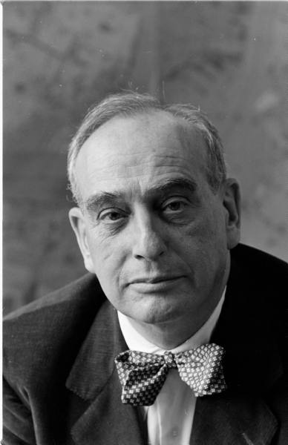
Robert Moses
New York Park Commissioner
Google Life

Slide 5
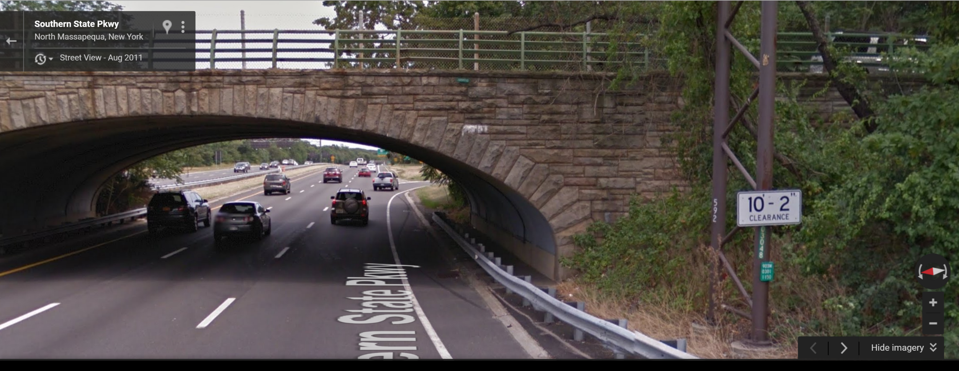
Google Maps

Slide 6
Data has become public infrastructure

Slide 7
Infrastructure can lift populations or it can oppress them.

Slide 8


Slide 9
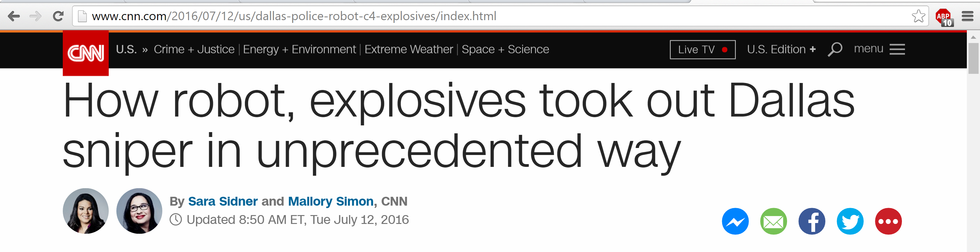

Slide 10
Algorithms are not perfect.
Sensors are not exact.
Logs are not infallible.

Slide 11
Hardware fails a lot.
Software fails a whole lot more.

Slide 12
Content Warning:
Image of raw meat, blurry video

Slide 13
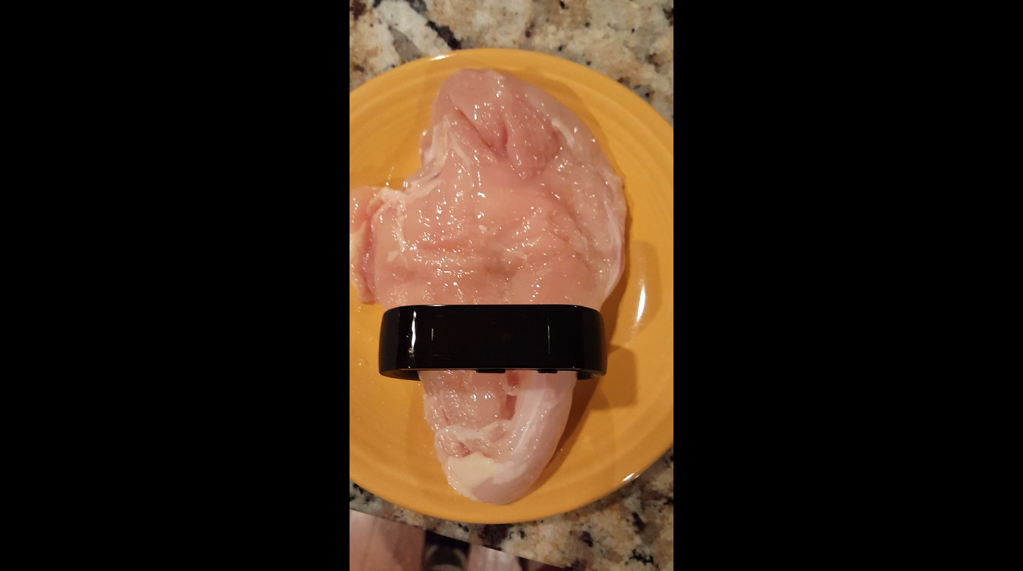

Slide 15
In 2015, police dismissed a woman’s rape claim when her Fitbit data contradicted her statement.

Slide 16
Earlier this year, she was convicted of lying to the police.
The prosecutor said the Fitbit data “sealed the deal.”

Slide 17
Who gets put on probation when a device makes false statements?
Who’s responsible when an algorithm causes an accident?

Slide 18
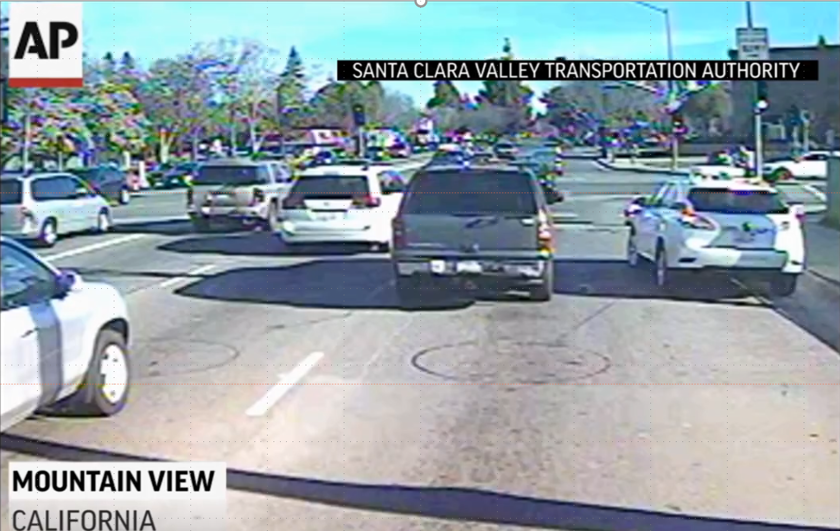

Slide 19
Google acknowledged fault:
The car “predicted that [the bus] would yield to us because we were ahead of it.”
http://www.theverge.com/2016/3/9/11186072/google-self-driving-car-bus-crash-video

Slide 20
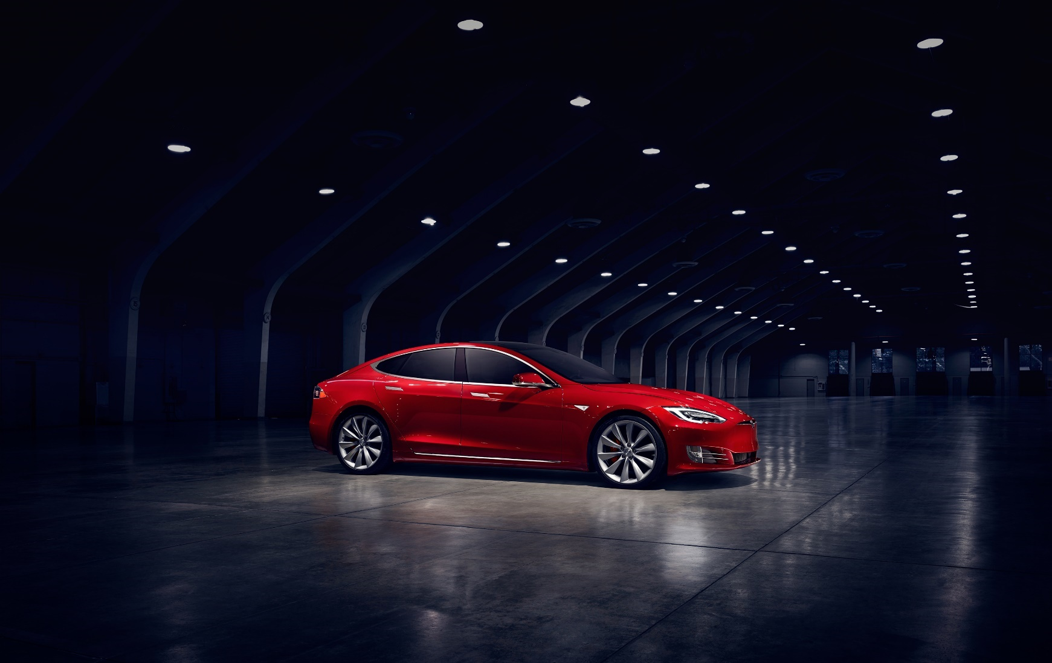
Numerous claims
One fatality
https://www.tesla.com/presskit

Slide 21
“It is important to note that Tesla… requires explicit acknowledgement that the system is new technology and still in a public beta phase”
https://www.tesla.com/blog/tragic-loss

Slide 22
“That contrasted against worldwide accident data, customers using Autopilot are statistically safer than those not using it at all”
https://www.tesla.com/blog/misfortune

Slide 23
“So the actions of autonomous robots devising their own means to attain a task may not be subject to liability under any of theories of tort…”
The Hon. Curtis E. A. Karnow The application of traditional tort theory to embodied machine intelligence The Robotics and Law Conference, Stanford, CA, 2013

Slide 24
IoT technology is almost entirely unregulated.

Slide 25
IoT technology can even expose data protected by regulations.

Slide 26
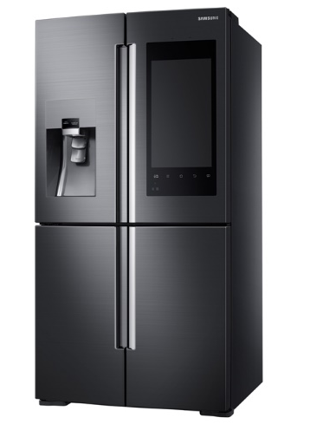
Samsung Family Hub™
Takes photo every time doors closed
http://www.samsung.com/us/explore/family-hub-refrigerator/
OS&Feelings 2016

Slide 27
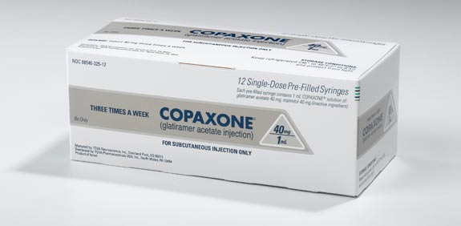
Copaxone®
MS drug
Requires refrigeration
https://multiplesclerosisnewstoday.com/wp-content/uploads/2015/04/Copaxone.jpg
OS&Feelings 2016

Slide 28
Tech hates regulation

Slide 29
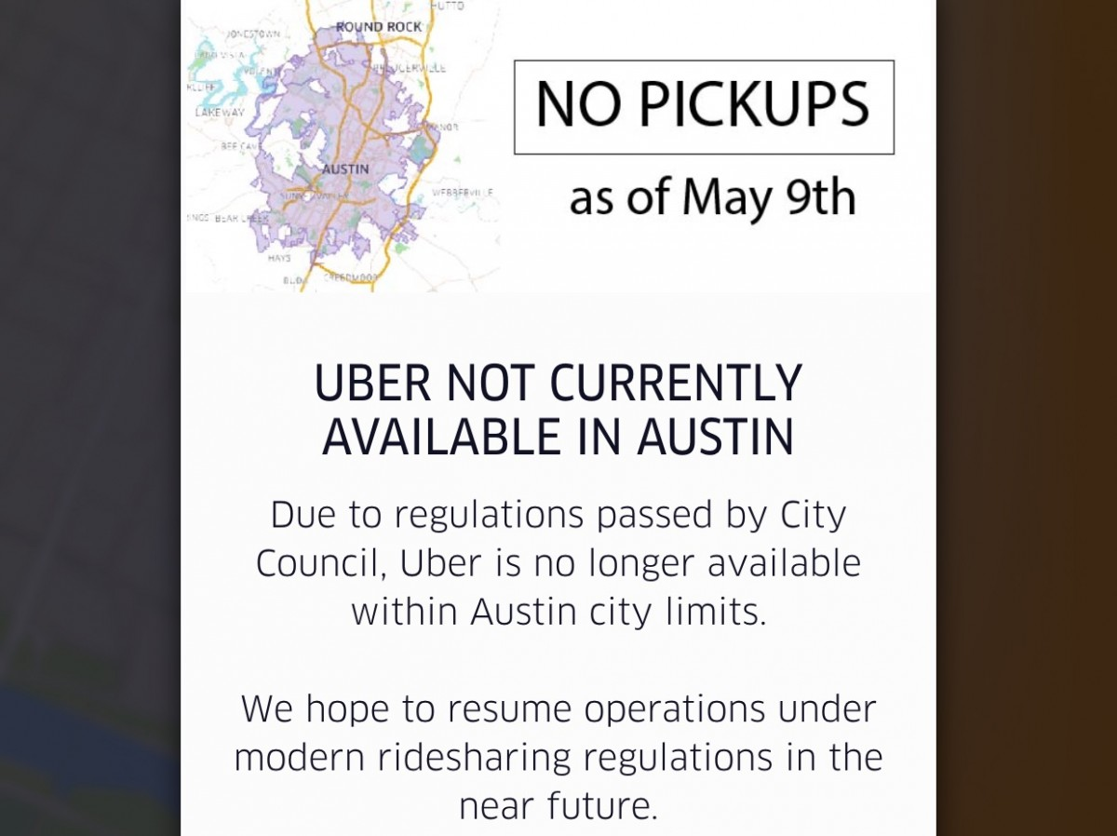
http://www.forbes.com/sites/briansolomon/2016/05/09/what-uber-and-lyfts-austin-retreat-means-for-ride-sharing/#2fb57841471c

Slide 30
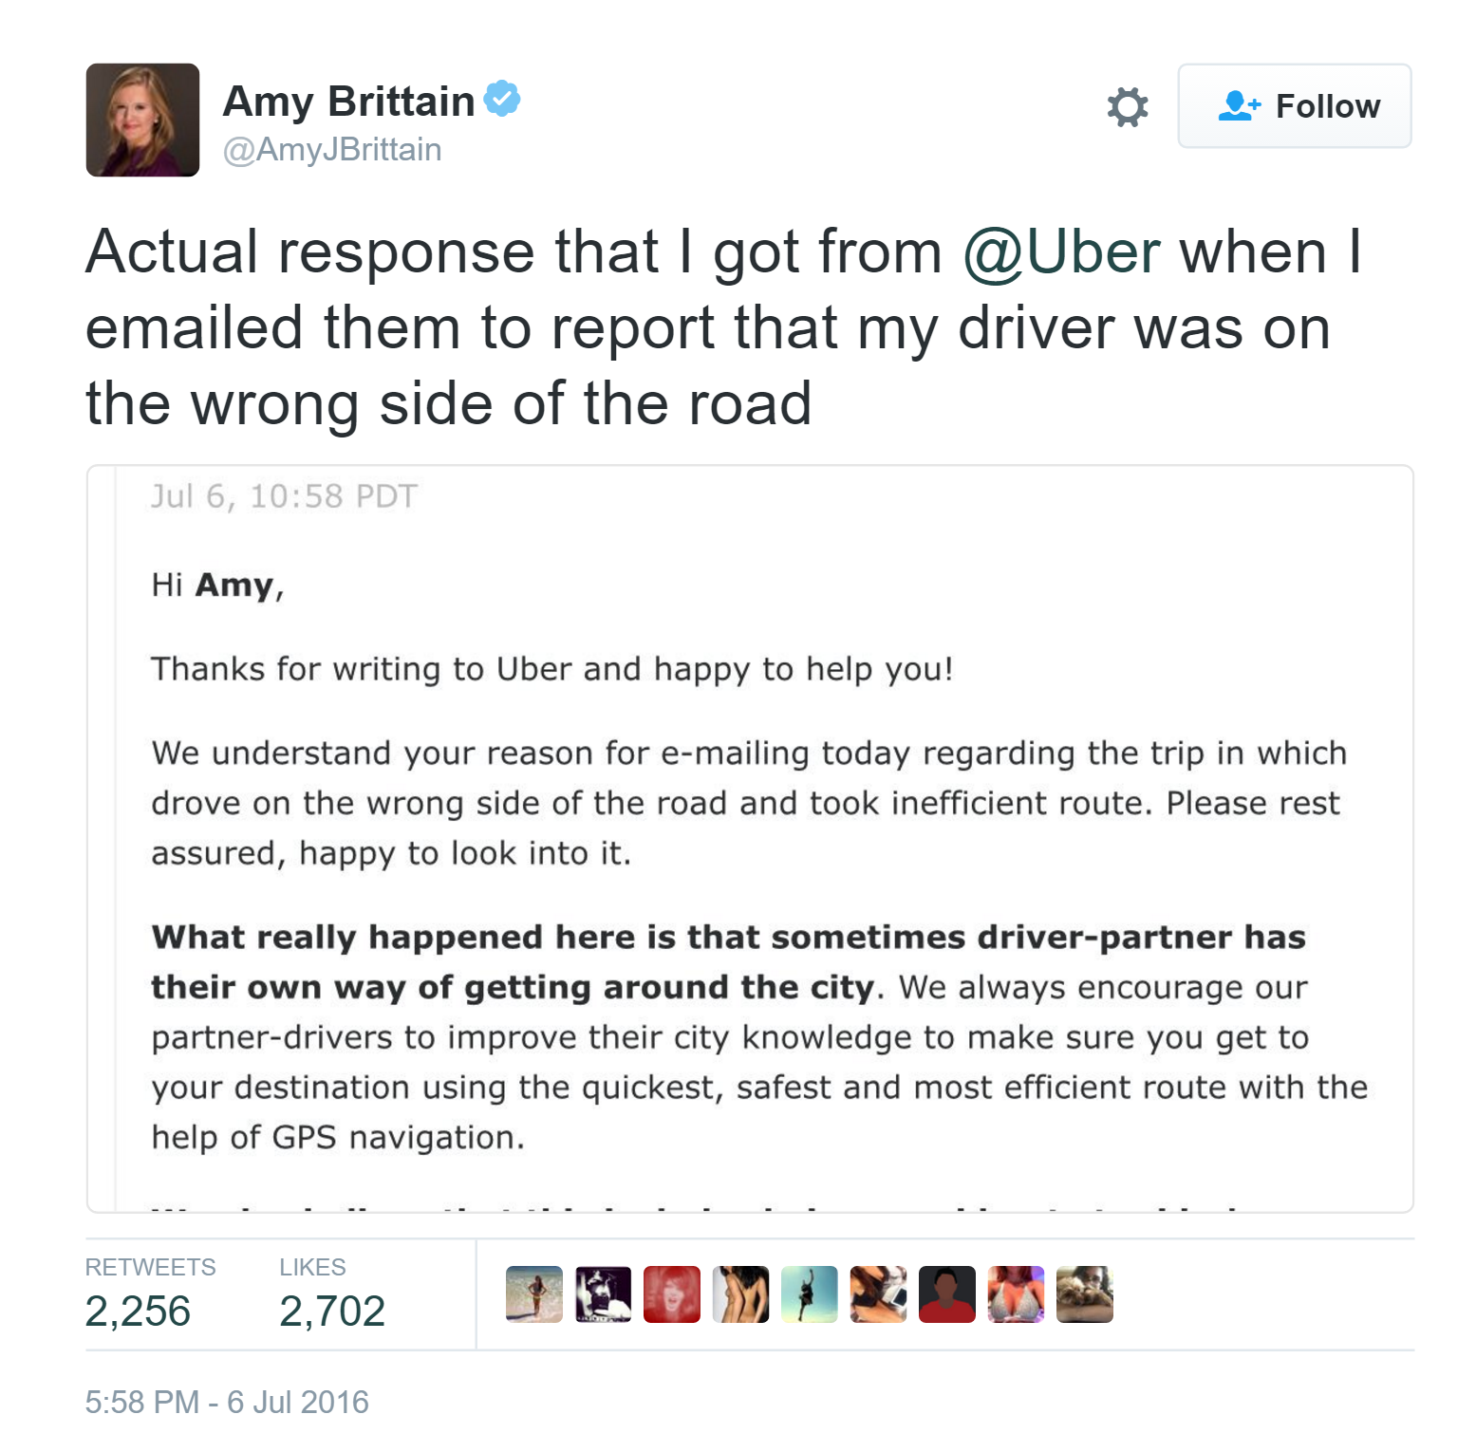

Slide 31
Yet IoT opportunities abound in regulated industries. Example:
Medical Devices

Slide 32
Medical device manufacturers are responsible for quality control of all aspects of their software.

Slide 33

Software
Of
Unknown
Pedigree
Eli Hodapp (CC Attribution 2.0 Generic) https://en.wikipedia.org/wiki/File:Chicken_noodle_soup_(cropped).jpg

Slide 34
No Code of Conduct?
You’re not mature enough to make safety-critical software.

Slide 35
There is no openness without accountability and transparency.

Slide 36
Software regulations are about accountability.

Slide 37
left-pad

Slide 38
The leftpad incident exposed a security and oversight vulnerability in OSS distribution.

Slide 39
In web development, broken builds mean bad days.
In IoT, broken builds mean material harm.

